Slide 1
Computer Graphics & IMAGE PROCESSING
CST304
Module - 1 Part -1
TEXT BOOK:
COMPUTER GRAPHICS – DONALD HEARN & M. PAULINE BAKER

Slide 2
Module – 1
(Basics of Computer Graphics and Algorithms)
Basics of Computer Graphics and its Applications
Video Display devices-
Refresh Cathode Ray Tubes
Random Scan Displays and systems
Raster Scan Displays and systems
Line Drawing algorithms-
DDA Line algorithm
Bresenham’s Line algorithm
Circle Drawing algorithms-
Midpoint Circle generation algorithm
Bresenham’s Circle algorithm

Slide 3
Basics of Computer Graphics and its Applications
William Fetter coined term “computer graphics” in 1960 to describe new design methods.
Imaging = representing 2D images
Modeling = representing 3D objects
Rendering = constructing 2D images from 3D models
Animation = simulating changes over time

Slide 4
What is Computer Graphics?
Computer graphics is the Creation, Manipulation and Storage of geometric objects (modeling) & their images (rendering) and display those images on screens or hardcopy devices.
Such models come from diverse and expanding set of fields including physical, mathematical, art, biological, and even conceptual (abstract) structures

Slide 5
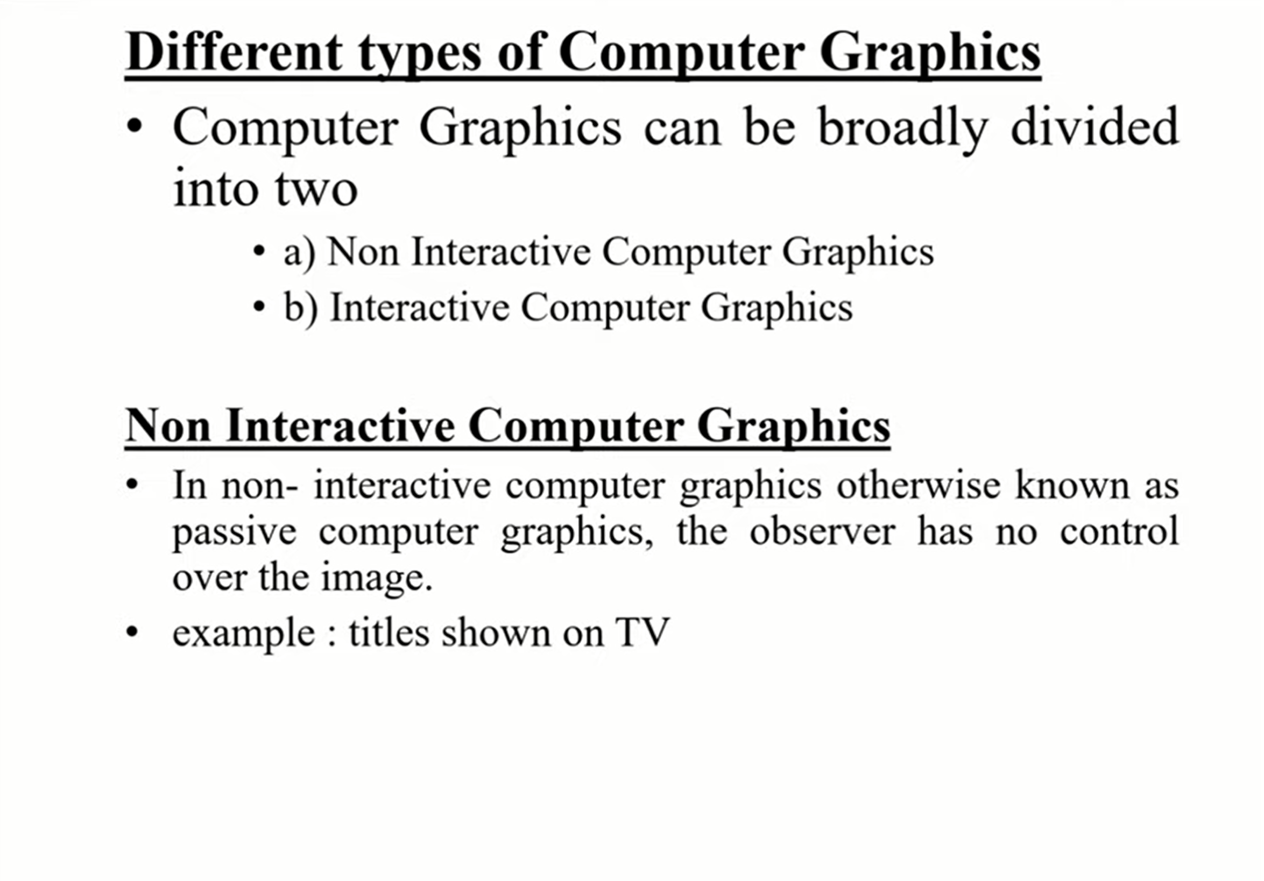

Slide 6
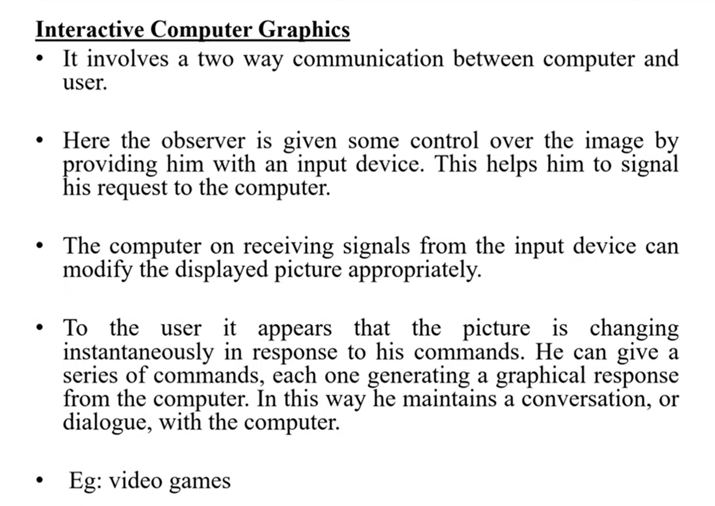

Slide 7
Applications of Computer Graphics
Computer Aided Design (CAD)
Presentation Graphics
Computer Art
Entertainment (animation, games, …)
Education & Training (Simulation)
Visualization (scientific & business)
Image Processing
Graphical User Interfaces

Slide 8
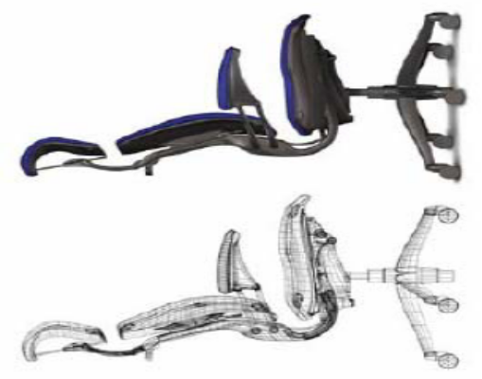
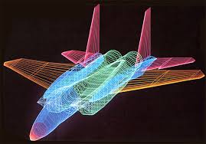
1.Computer Aided Design (CAD)
  Used in the design of buildings, automobiles, aircraft, watercraft, spacecraft, computers, textiles & many other products
  Objects are displayed in wire frame outline form that shows the overall shape and internal features of objects
  Software packages provide multi-window environment

Slide 9
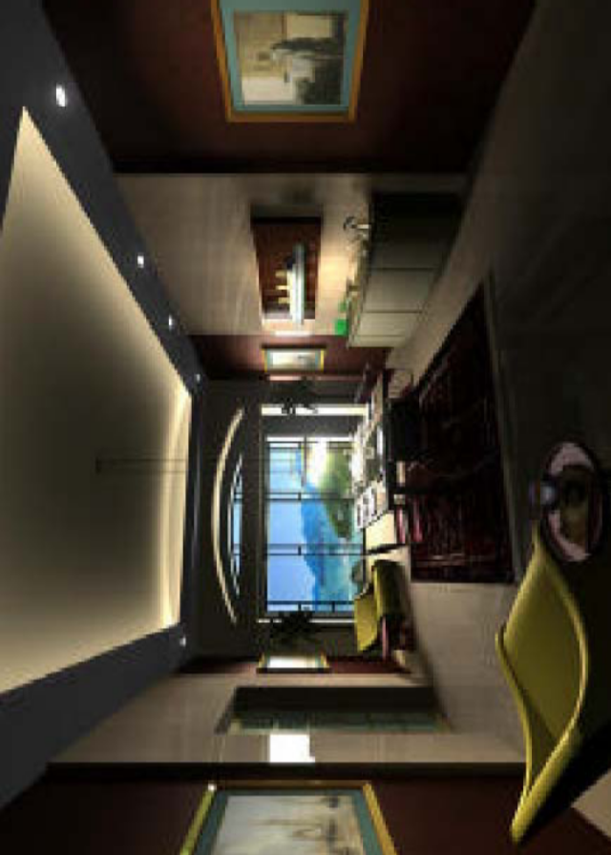
(CAD / CAM)
Computer graphics has a dramatic impact on the design and engineering process
  Architectural design
Architecture, Engineering, Construction
Product Design
Final product appearance

Slide 10
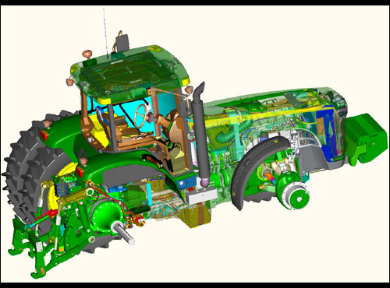
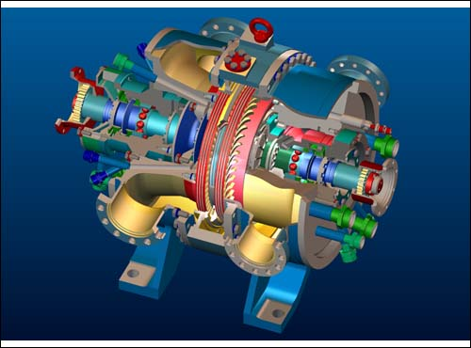
Graphics design package provides standard shapes (useful for repeated placements)
Animations are also used in CAD applications
Realistic displays of architectural design permits simulated “walk” through the rooms (virtual-reality systems)

Slide 11
2.Presentation Graphics
Used to produce illustrations for reports or generate slides for use with projectors
Commonly used to summarize financial, statistical, mathematical, scientific, economic data for research reports, managerial reports & customer information bulletins
Examples: Bar charts, line graphs, pie charts, surface graphs, time charts,etc.

Slide 12
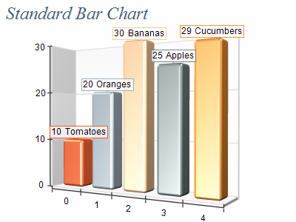
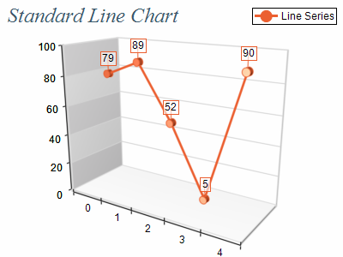
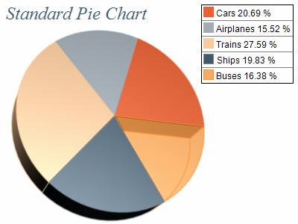
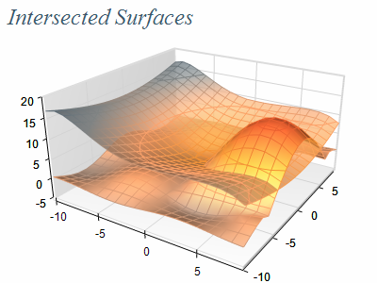
Examples of presentation graphics

Slide 13
3.Computer Art
Computer graphics methods are widely used used in fine art & commercial art
  Includes artist’s paintbrush programs, paint packages, CAD packages and animation packages
  These packages provide facilities for designing object shapes & specifying object motions.
  Examples: Cartoon drawings, paintings, product advertisements, logo design, etc.

Slide 14
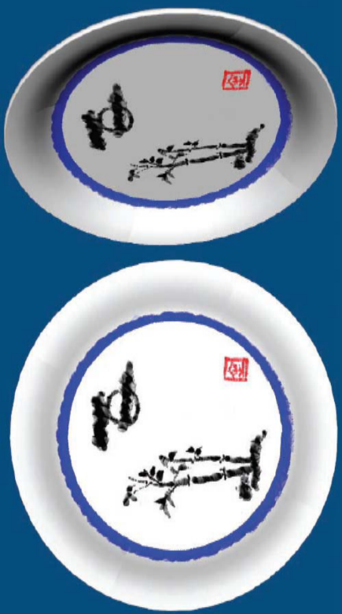
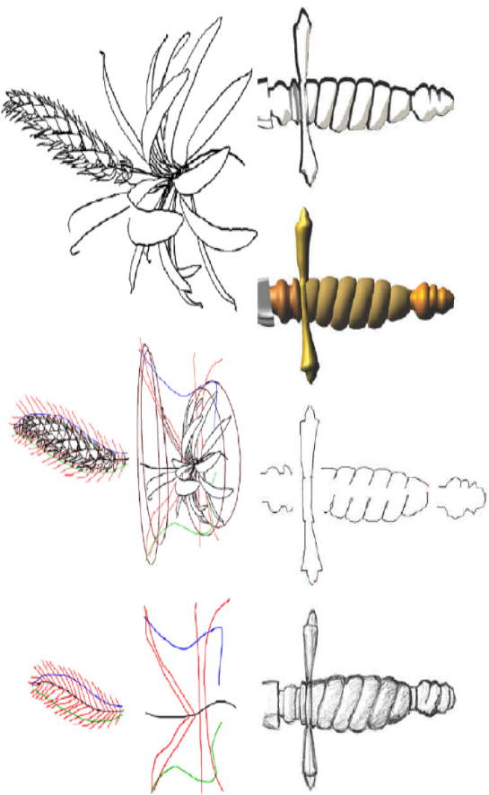
Computer Art
Digital Painting
Sketch-Based Modeling

Slide 15
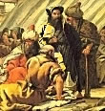
Computer Art
Electronic painting
  Picture is painted electronically on a graphics tablet (digitizer) using a stylus which is cordless, pressure sensitive
Morphing
  A graphics method in which one object is transformed into another

Slide 16
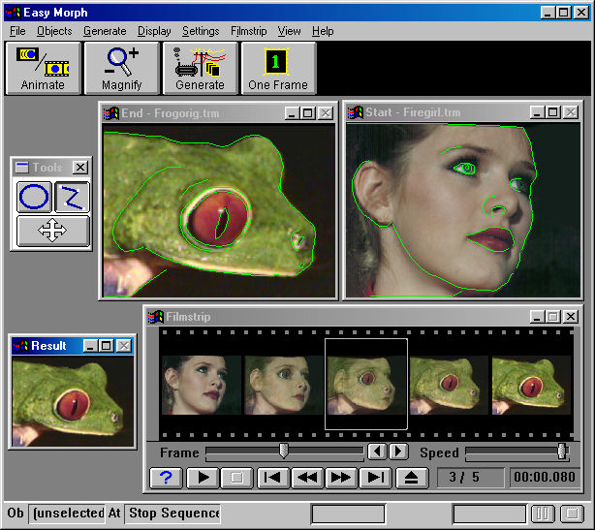
Example: Morphing

Slide 17


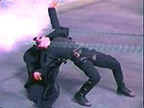
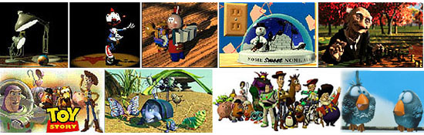
4.Entertainment
Movie Industry
  Used in motion pictures, music videos,
  and television shows.
  Used in making of cartoon animation films
Slide information from Leonard McMillian's slides
http://www.cs.unc.edu/~mcmillan/comp136/Lecture1/compgraf.html

Slide 18
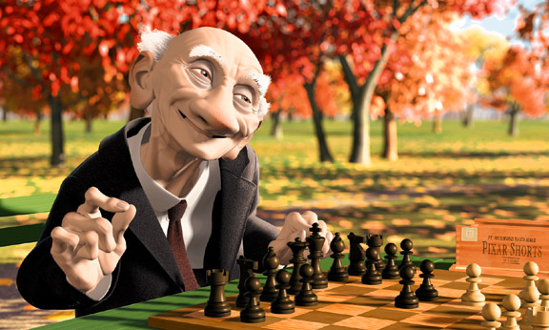

Movie Industry
Computer Graphics is about animation (films)

Slide 19

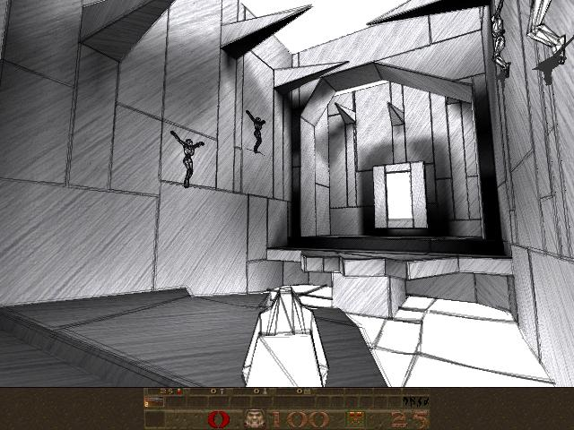
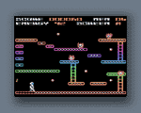
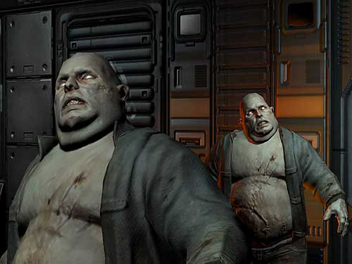
Game Industry
  Focus on interactivity
  Cost effective solutions
  Avoiding computations and other tricks

Slide 20
5.Education and Training
Computer generated models of physical, financial and economic systems are used as educational aids
For some training applications, special systems are designed
Models of physical systems, physiological systems, population trends, or equipment such as color-coded diagrams help trainees understand the system’s operation

Slide 21
Specialized systems used for training applications
  Simulators for practice sessions and training of :
  ship captains
  aircraft pilots
  heavy equipment operators
  air traffic-control personnel

Slide 22
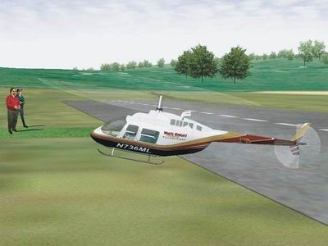
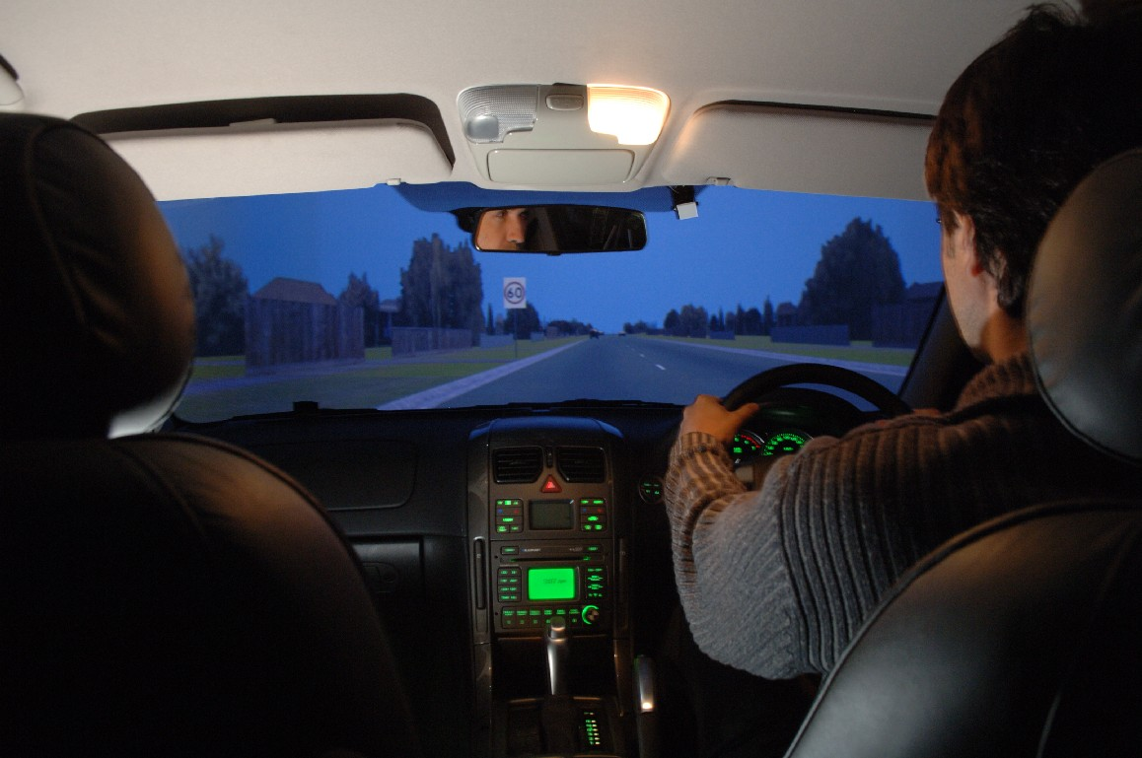
Training and Simulation

Slide 23
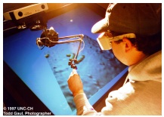
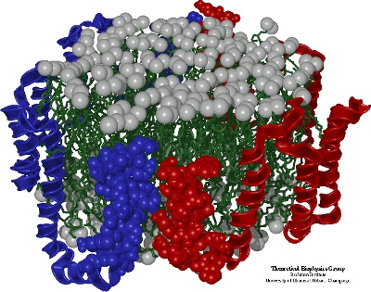
6.Visualization
Scientific Visualization deals with producing graphical representations for scientific, engineering, and medical data sets.
Notes:
Bulk amount of data sets

Slide 24
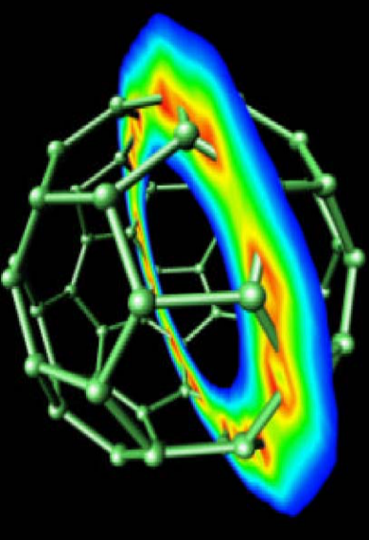
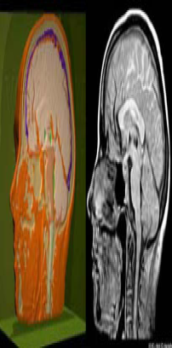
Scientific Visualization
Scientific data representation
Picture vs. stream of numbers
Medical imaging & visualization

Slide 25
Business Visualization is used in connection with data sets related to commerce, industry and other non-scientific areas
Techniques used are color coding, contour plots, graphs, charts, surface renderings & visualizations of volume interiors.
Image processing techniques are combined with computer graphics to produce many of the data visualizations

Slide 26
7. Image Processing
In Computer Graphics computer is used to create a picture
Image Processing applies techniques to modify or interpret existing pictures such as photographs and TV scans
Medical applications
  Picture enhancements
  Tomography
  Simulations of operations
  Ultrasonics & nuclear medicine scanners
Applications of image processing
  Improving picture quality
  Machine perception of visual information (Robotics)
Notes:
Plat diseases
Satellite images-presence of war
Presence of missiles

Slide 27
To apply image processing methods
  Digitize a photograph (or picture) into an image file
  Apply digital methods to rearrange picture parts to:
    Enhance color separations
    Improve quality of shading
  Tomography – technique of X-ray photography that allows cross-sectional views of physiological systems to be displayed
  Computed X-ray tomography (CT) and position emission tomography ( PET) use projection methods to reconstruct cross sections from digital data
  Computer-Aided Surgery is a medical application technique to model and study physical functions to design artificial limbs and to plan & practice surgery

Slide 28
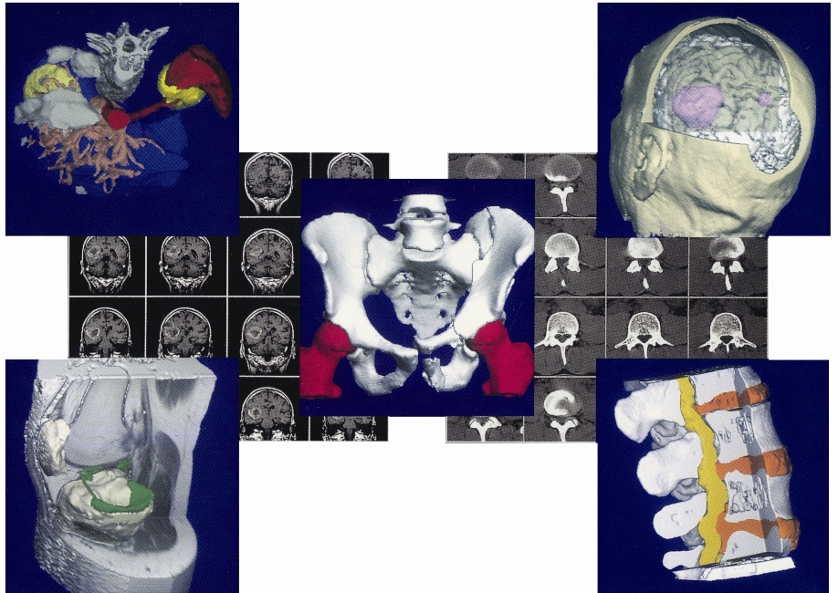
Image Processing

Slide 29
8.Graphical User Interfaces
It is common now for software packages to provide a graphical interface.
Major component of a graphical interface is Window manager that allows a user to display multiple-window areas
To make a particular window active, click in that window using an interactive pointing device
Interfaces display menus & icons
Icons graphical symbol designed to look like the processing option it represents
Advantages of icons are less screen space, easily understood
Menus contain lists of textual descriptions & icons

Slide 30
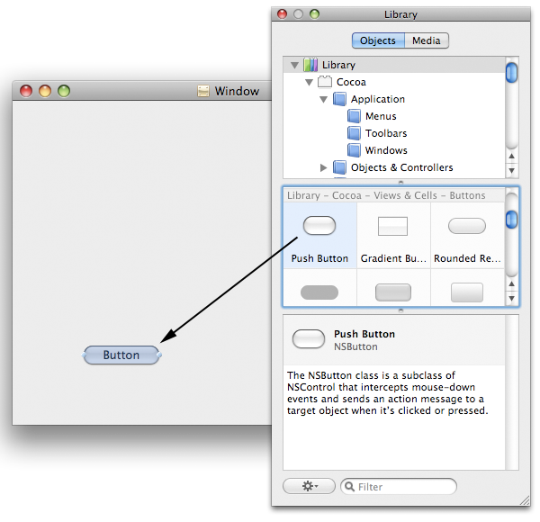
Graphical User Interface

Slide 31
Graphics Packages
A set of libraries that provide programmatically access to some kind of graphics 2D functions.
Types
  GKS-Graphics Kernel System – first graphics package, accepted by ISO & ANSI
  PHIGS (Programmer’s Hierarchical Interactive Graphics Standard) accepted by ISO & ANSI
  PHIGS + (Expanded package)
  Silicon Graphics GL (Graphics Library)
  Open GL
  Pixar Render Man interface
  Postscript interpreters
  Painting, drawing, design packages

